Slide 1
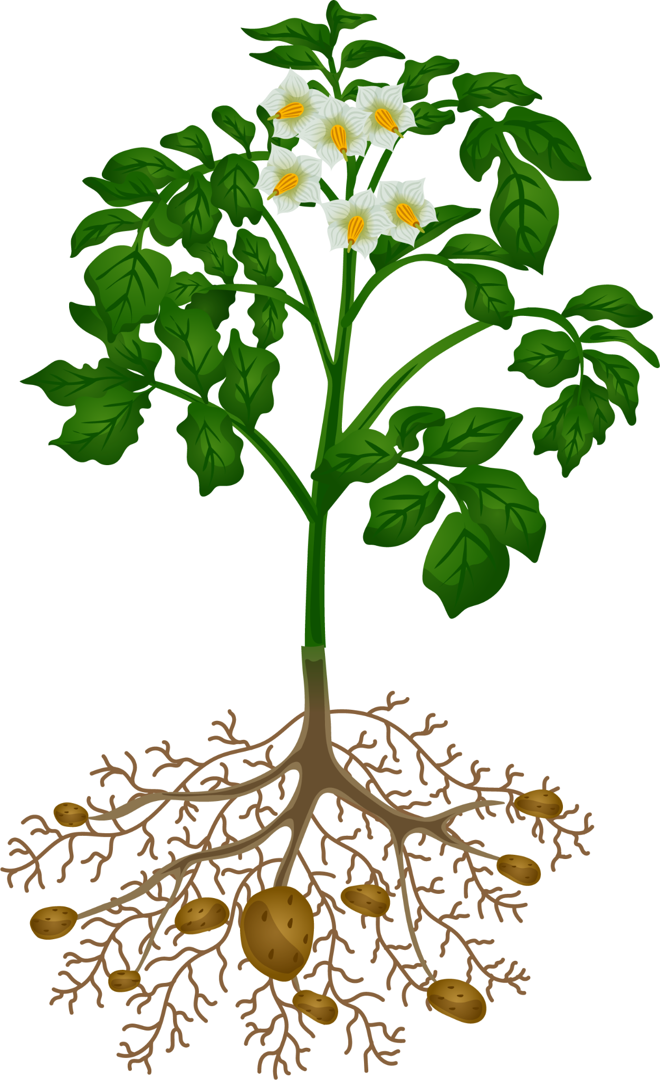
Plant Disease Detection and Diagnosis System
.
Team members: 1. George Bebawy
2. Ahmed Hamdy
3. Youssef Ahmed

Slide 2
Table of contents
01
Intro & objectives
Goals of the Project
Dataset Overview
02
03
04
Data Preprocessing
05
Model Architecture & Summary
Deployment & Results
06

Slide 3
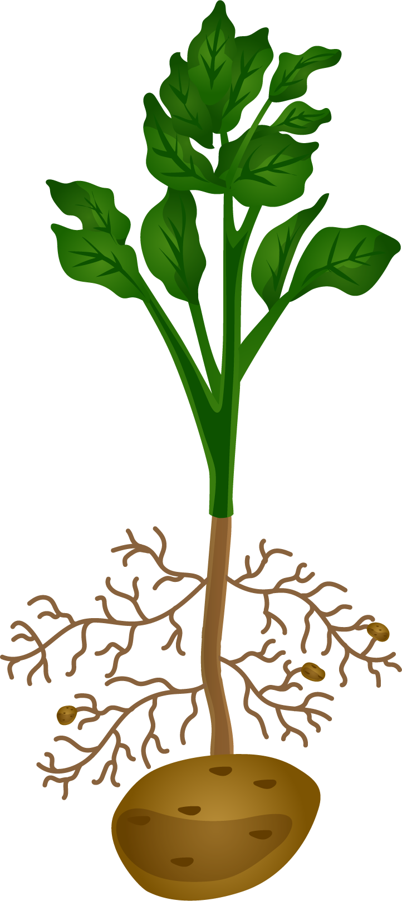
01
Intro & objectives

Slide 4
Introduction
Our project, Plant Disease Detection and Diagnosis System, is designed to assist farmers, gardeners, and plant enthusiasts by leveraging AI to analyze images of plants and provide crucial insights about their health. The system functions in three key steps:
Identifying the Plant Type: Using image recognition, the system determines the species of the plant and provides a confidence percentage. For instance, it might predict with 90% certainty that the plant is an apple tree.
Assessing Plant Health: Once the plant type is identified, the system analyzes whether the plant is healthy or displaying symptoms of disease.
Diagnosing the Disease: If the plant is sick, the system identifies the specific disease and provides a detailed description of it.
By making plant health analysis quick and accessible, our goal is to help protect crops, reduce plant loss, and ensure healthier harvests.

Slide 5
Objective
The primary objective of this project is to develop a system capable of:
Identifying Plant Types: Determine plant species from images with high confidence.
Detecting Plant Health: Quickly assess if a plant is healthy or sick.
Diagnosing Plant Diseases: Identify specific diseases and provide detailed information for timely treatment.
Displaying Confidence Levels: Offer percentage-based confidence in predictions to enhance accuracy and decision-making.
This solution aims to provide valuable insights, improve agricultural productivity, and contribute to sustainable farming practices.

Slide 6
02
Goals of the Project

Slide 7
Goals
User-Friendly Experience:
Ensure that the platform is easy to use, providing farmers, gardeners, and plant lovers with a simple yet powerful tool for managing plant health.
Facilitate Real-Time Disease Detection:
Enable the system to provide real-time analysis so that users can receive instant feedback on plant health and potential diseases, allowing for quicker responses.

Slide 8
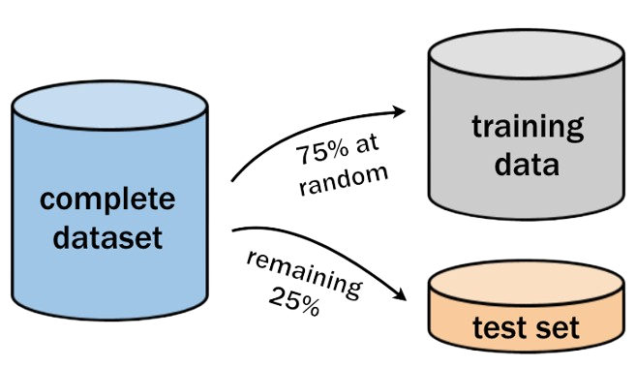
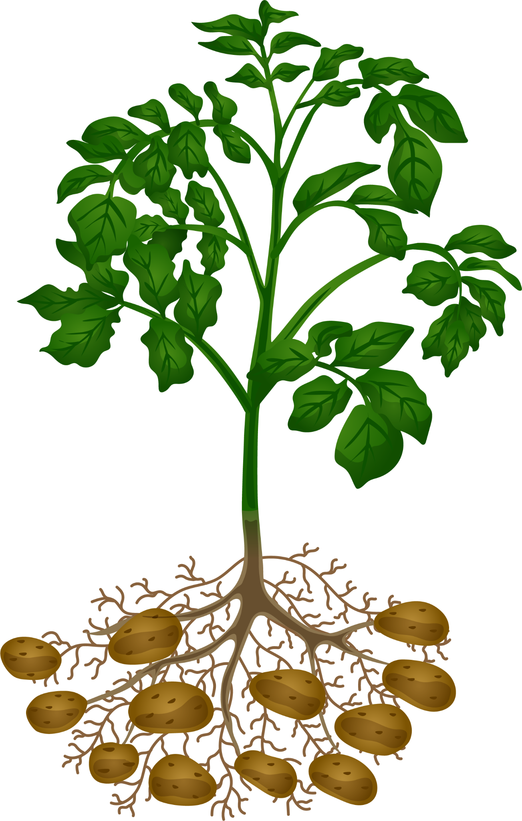
03
Dataset Overview

Slide 9
Dataset Overview
For the Plant Disease Detection and Diagnosis System, we have utilized the New Plant Diseases Dataset from Kaggle. This dataset plays a crucial role in training and testing the model's ability to accurately identify plant types and diagnose diseases.
Key features of the dataset include:
Total Images: The dataset consists of over 87,000 images of healthy and diseased plant leaves.
Plant Categories: It covers 38 distinct classes, representing both healthy and diseased plants from various species such as apple, cherry, corn, and grape.
Disease Types: The dataset includes images of plants affected by various diseases like Apple Scab, Black Rot, and Late Blight, among others.
High-Quality Images: All images are in RGB format and are of high resolution, which ensures that the model can extract fine details for better classification.
Diverse Conditions: The dataset includes images captured in different conditions, adding variability in lighting, angles, and environmental factors, which helps the model generalize well across real-world scenarios.

Slide 10
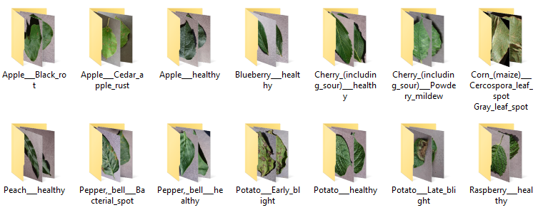
Dataset Overview

Slide 11
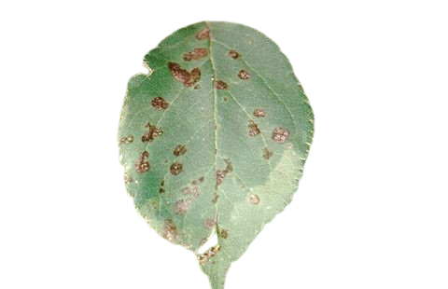
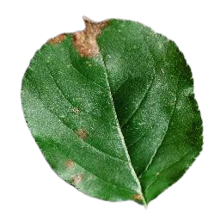
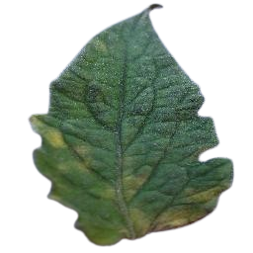
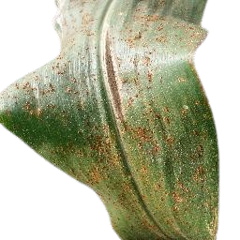
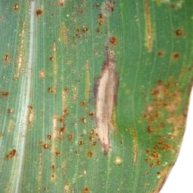
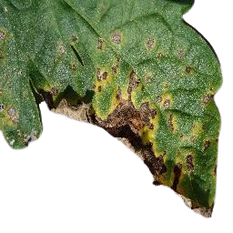
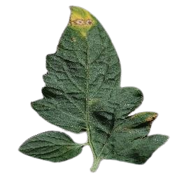
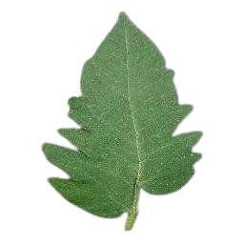
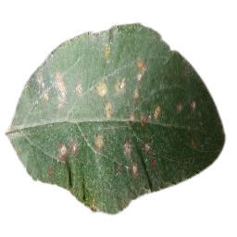
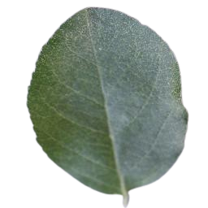
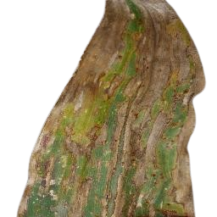

Dataset Diseases
Apple
Corn
Tomato
Apple-scab
Black-rot
Common-rust
Northern-Leaf-Blight
Leaf-Mold
Septoria-leaf-spot
Cedar-apple-rust
healthy
Gray-leaf-spot
healthy
Target-Spot
healthy

Slide 12
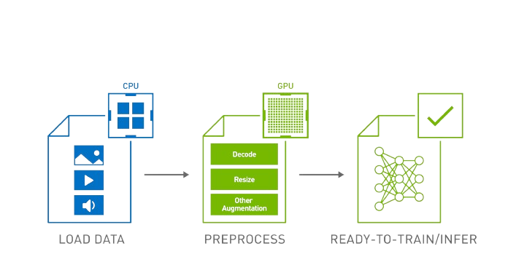
Data Preprocessing
04

Slide 13
Data Preprocessing
Data Preprocessing
Effective data preprocessing is a critical step in ensuring that the model can accurately classify plant types and detect diseases.
Dataset Splitting
The entire dataset is divided into three main subsets to ensure the model is trained, validated, and tested effectively Training -- Valid -- Test

Slide 14
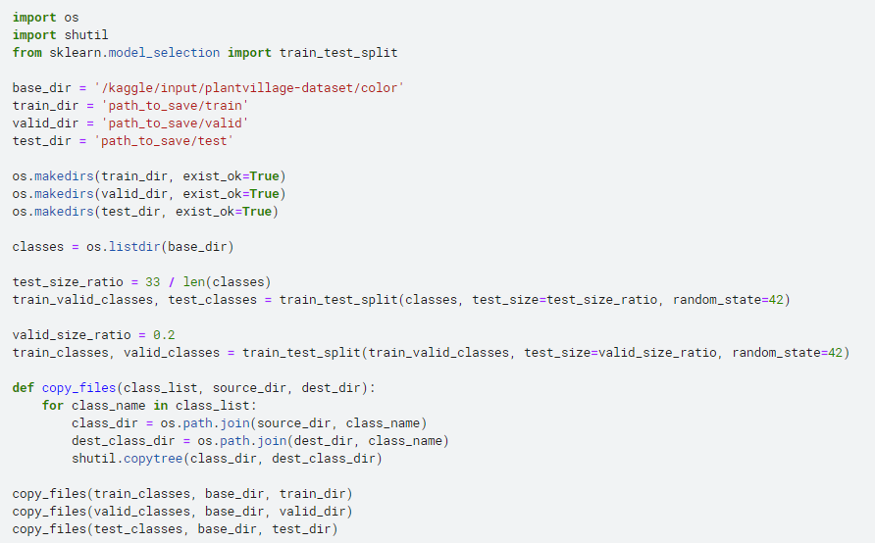
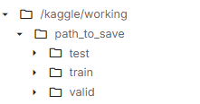
Dataset Splitting

Slide 15

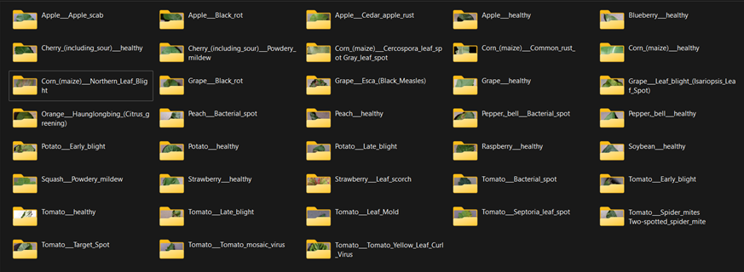
Dataset Overview
38 different classes “Training data set”

Slide 16
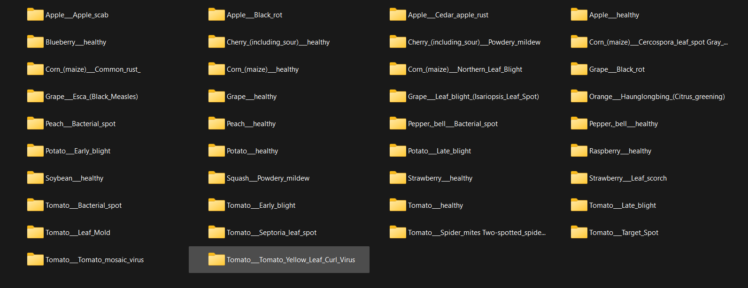
Dataset Overview
38 different classes “Validation data set”

Slide 17
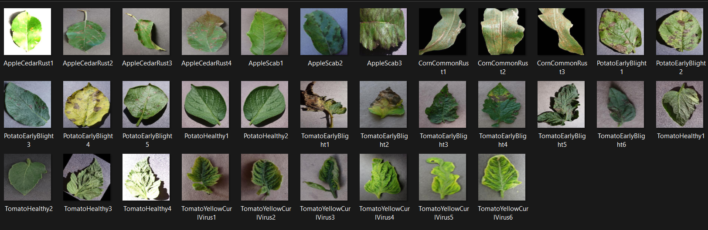
Dataset Overview
Testing Images

Slide 18
05
Model Architecture

Slide 19
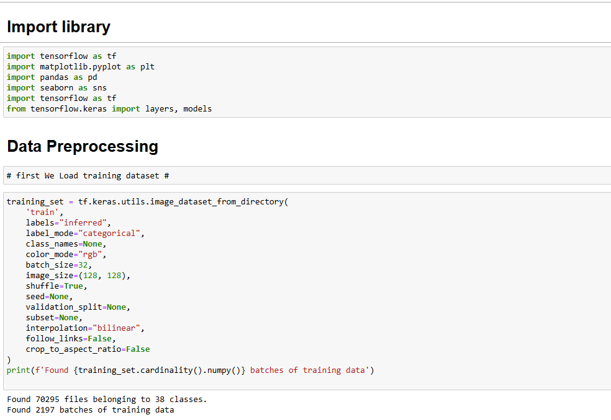
Model Architecture

Slide 20
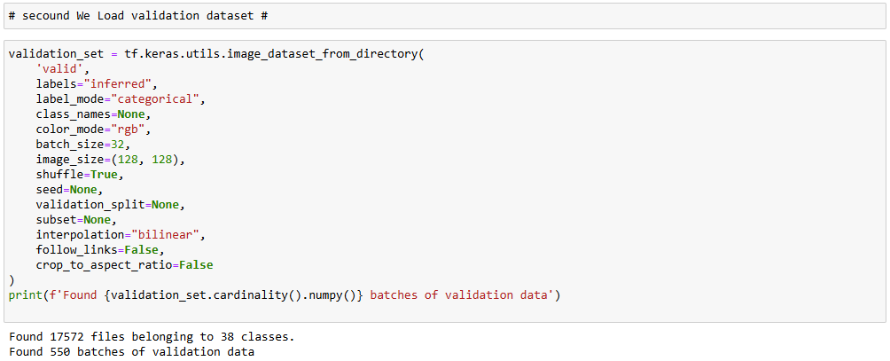
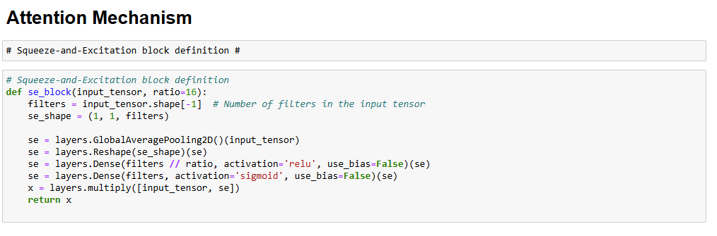
Model Architecture

Slide 21
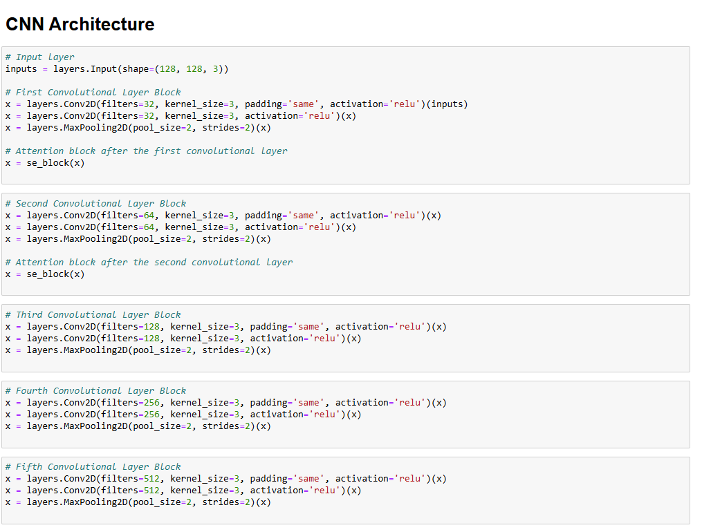
CNN
Model Architecture

Slide 22
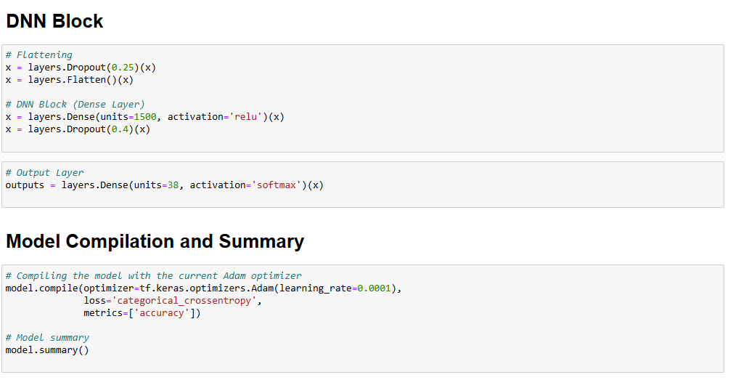
DNN
Model Architecture

Slide 23
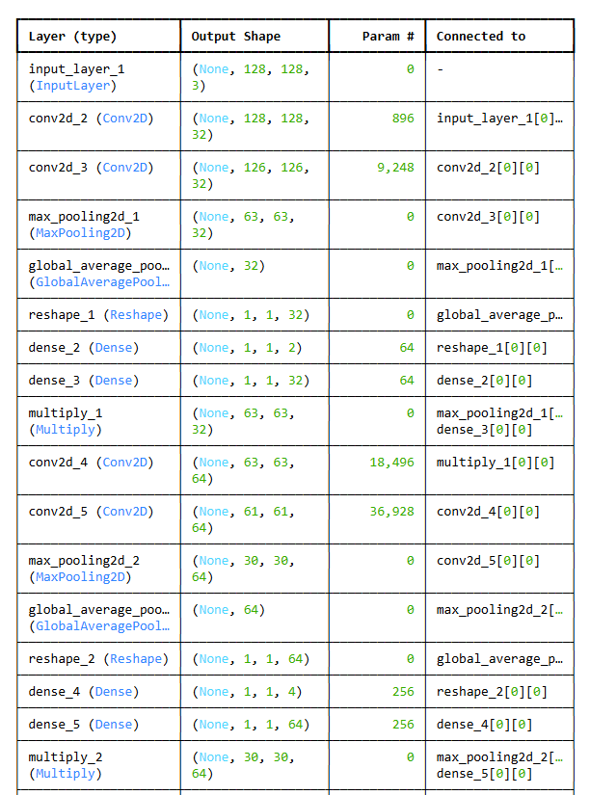
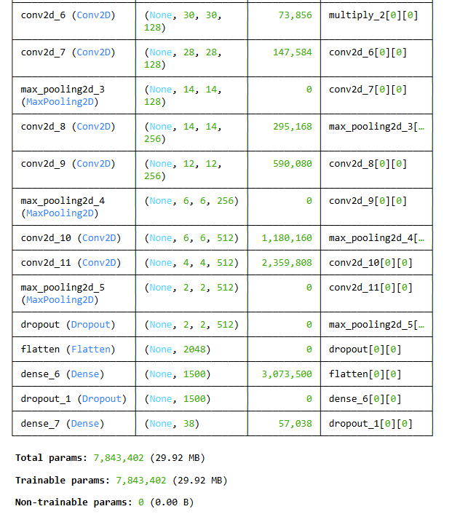
Model Summary

Slide 24
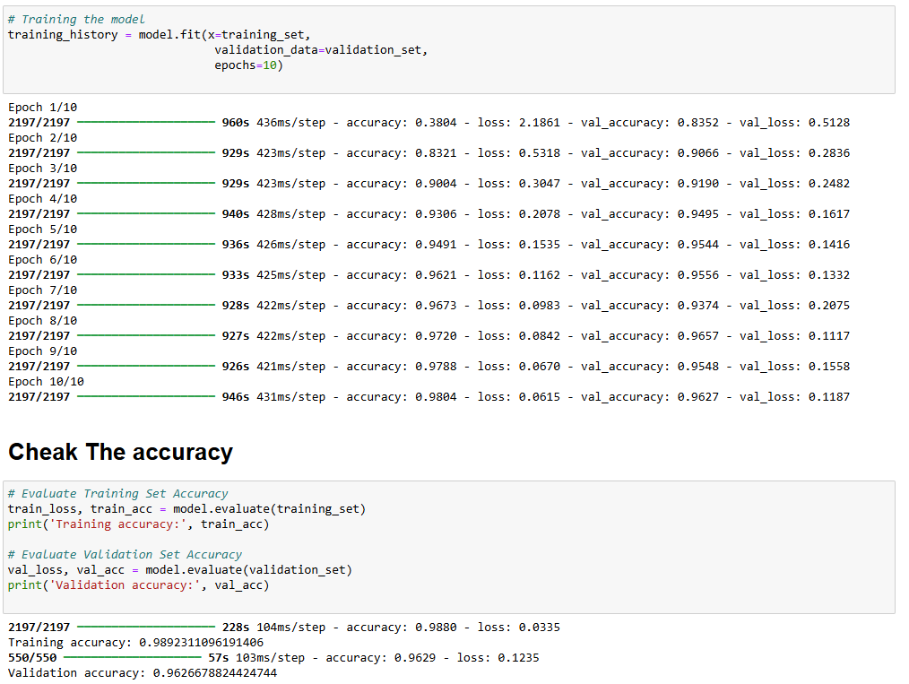

Model Summary

Slide 25
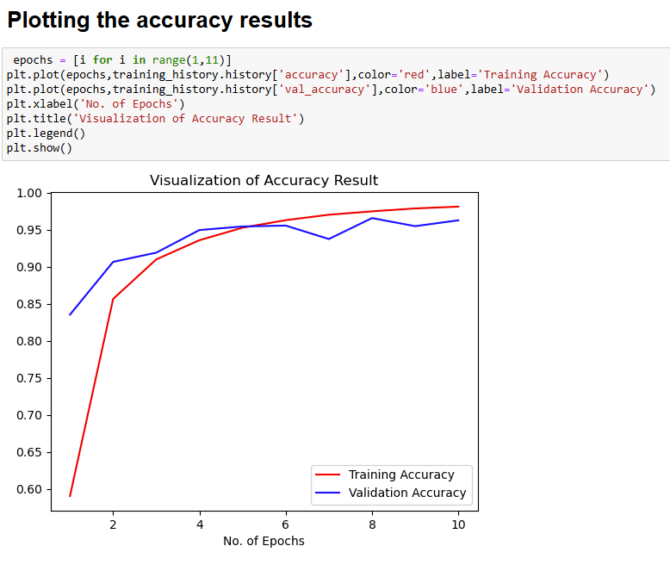
Model Summary

Slide 26
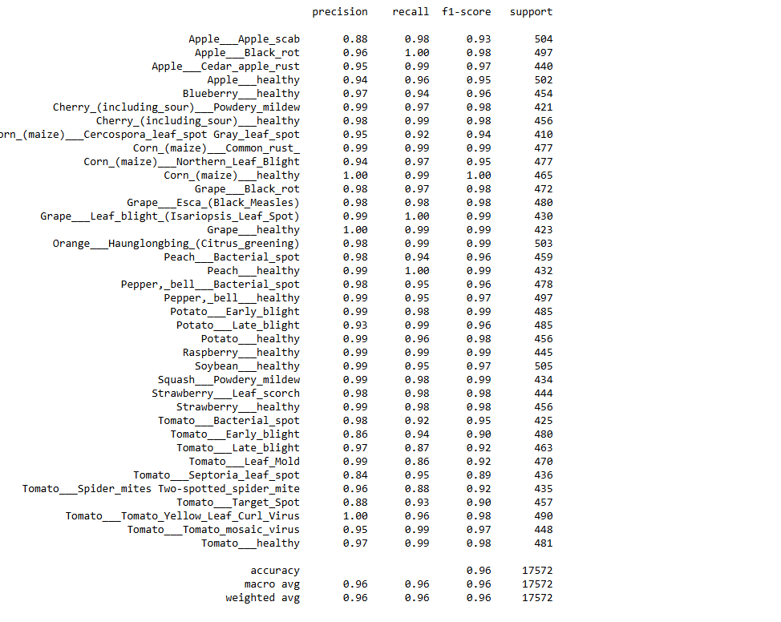

Model Summary

Slide 27
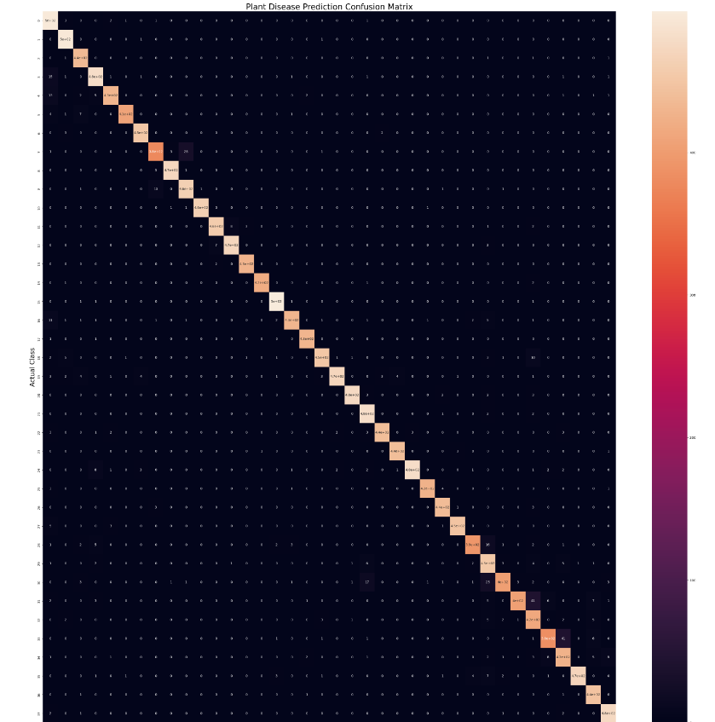
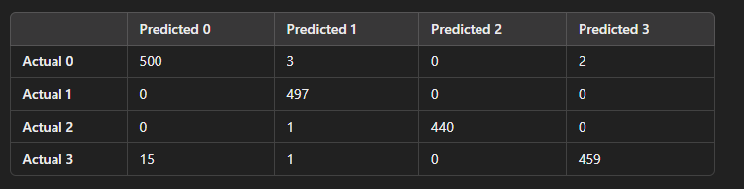
C.M
Model Summary

Slide 28
Model Deployment
06

Slide 29



Model Deployment
K
Streamlit
Tensor Flow
NumPy
Keras

Slide 30
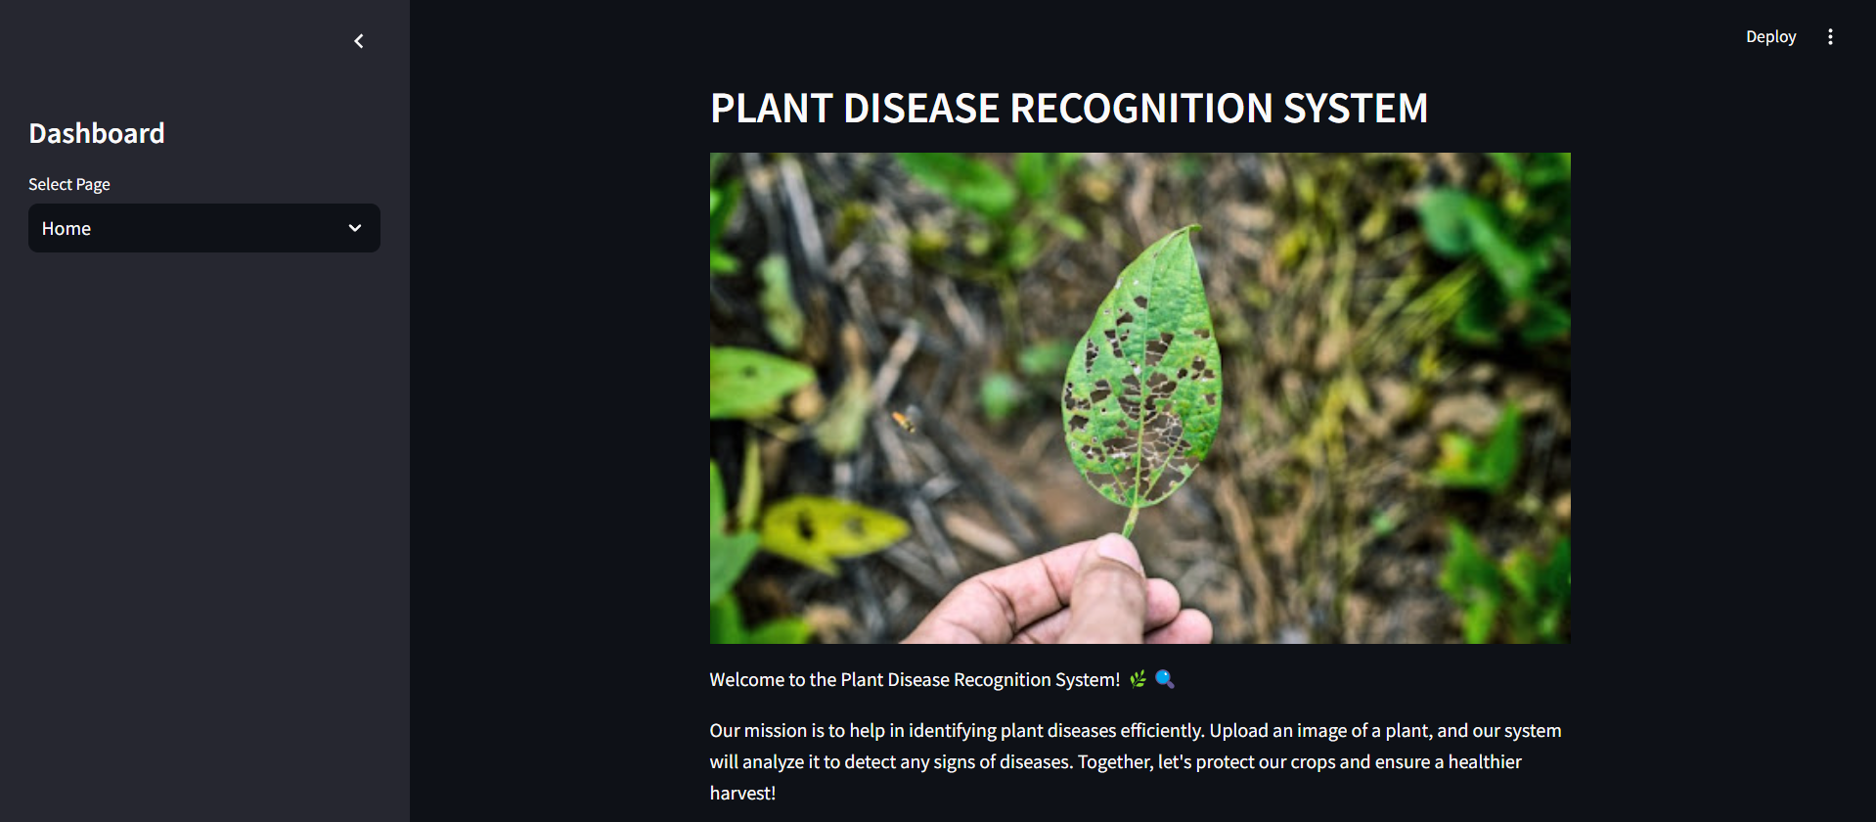
Model Deployment

Slide 31
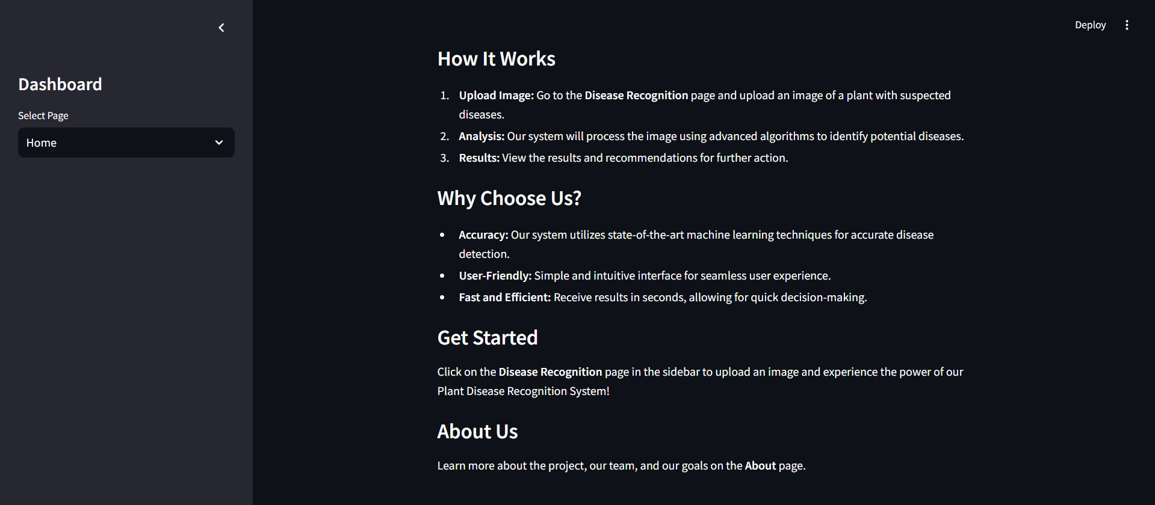
Model Deployment

Slide 32
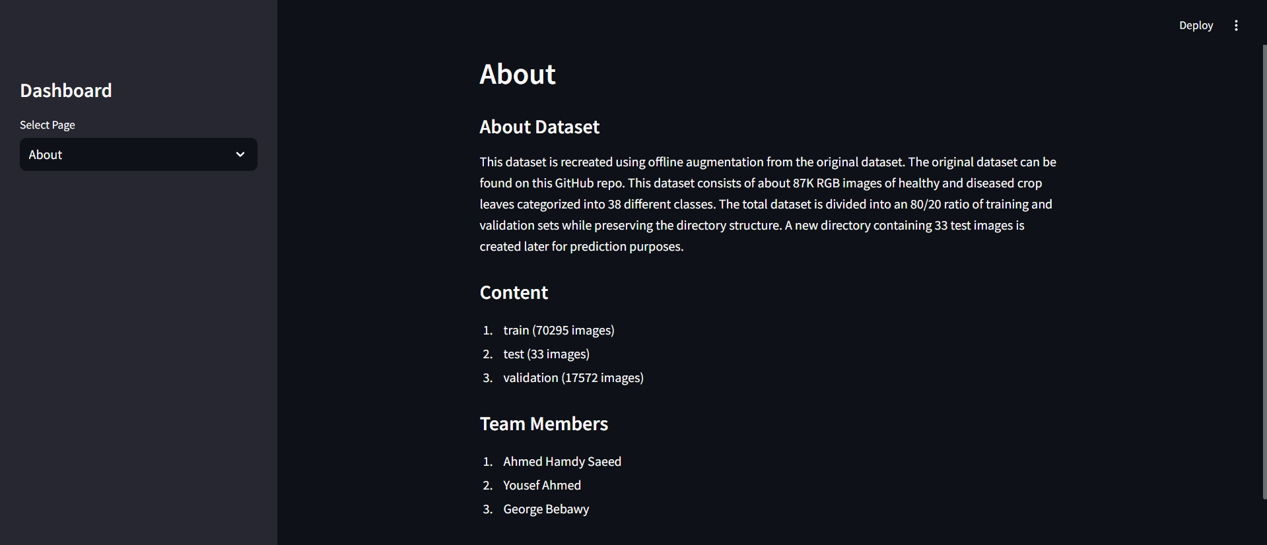
Model Deployment

Slide 33
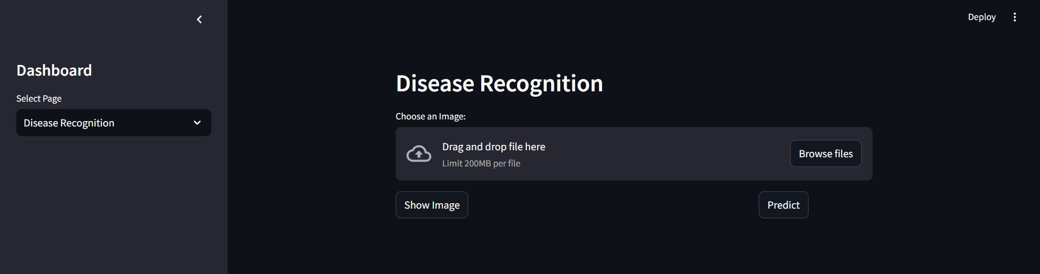
Model Deployment

Slide 34
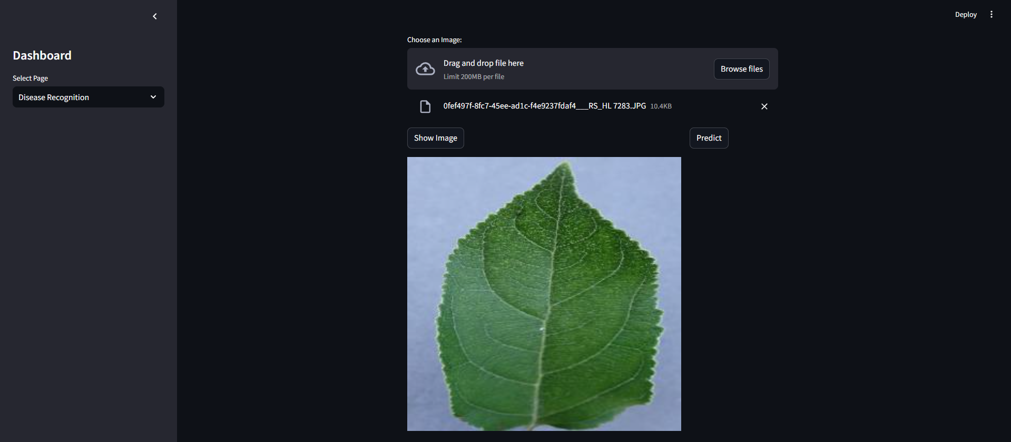
Model Deployment

Slide 35
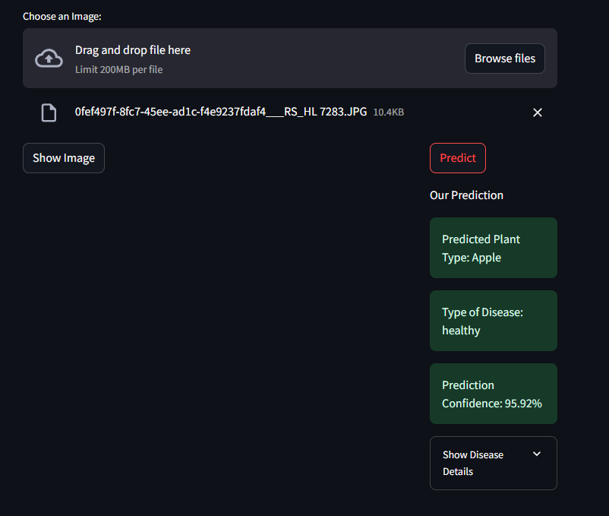
Model Deployment

Slide 36

Thanks!
Do you have any questions?

